Slide 1
T1S Autoconfiguration Tooling
Martin Ruppert

Slide 2
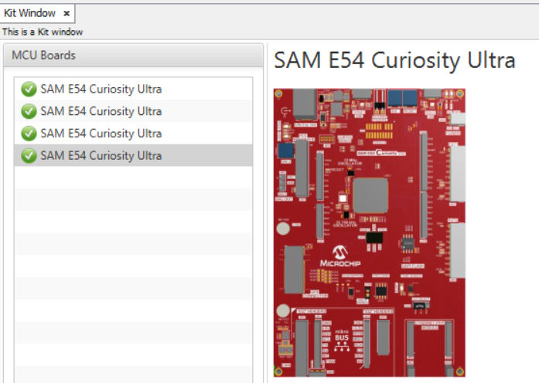
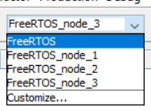
Motivation
When you have four T1S Nodes, you need 4 Evalkits and 4 different HEX files.
With conditional compiling you can have one project with four configuration
But allways compile four times a project and programming afterwards four board
Can be confusing and time consuming. How can this be done easier?

Slide 3
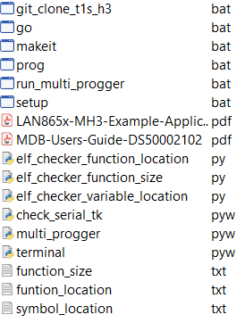
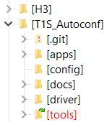
Github Project
git clone https://github.com/Bolderain/T1S_Autoconf
The script clones all neccessary Harmony repositories in the directory H3 (one directory level higher).
For beeing able to generate and and modify the T1S applications of version v1.3.0 with the MCC.
Call it from /tools

Slide 4
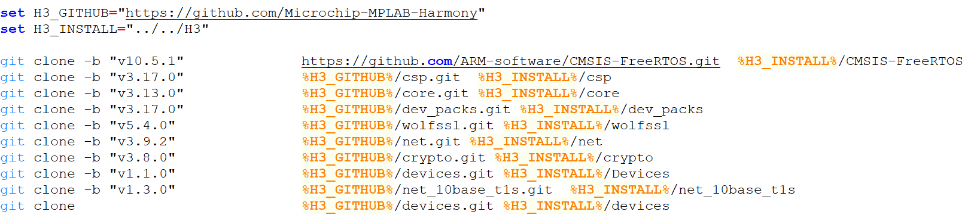
git_clone_t1s_h3.bat
This script clones several Harmony Repositories and checkout the needed versions

Slide 5
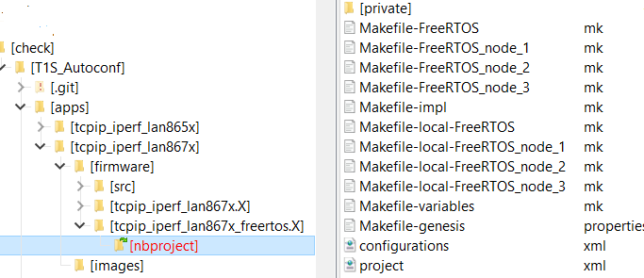
Github Project
The script setup.bat calls the „prjMakefilesGenerator.bat“
i.e. It creates all Makefiles. This is normally done by MPLABX when the project is opened. And allows to build the projects without using MPLABX

Slide 6
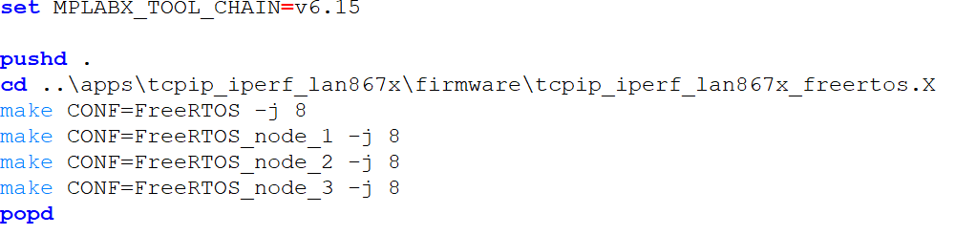
Github Project
The script „makeit.bat“ call the make utility to build all configuration on the command line

Slide 7
Github Project
The Tool „multi_progger.pyw“ is a Python Tkinter GUI that controlls 4 instances of the MDB Core simultary.
This allows to keep the connection to four MDB‘s instances and programming four controller at the same time.

Slide 8
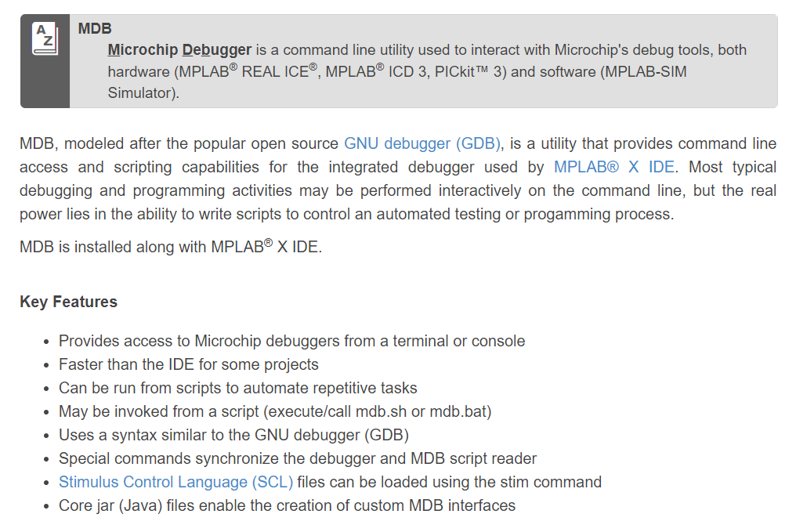
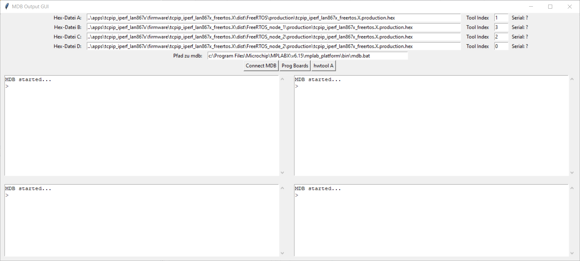
Python GUI for parallel Programming with MDB

Slide 9
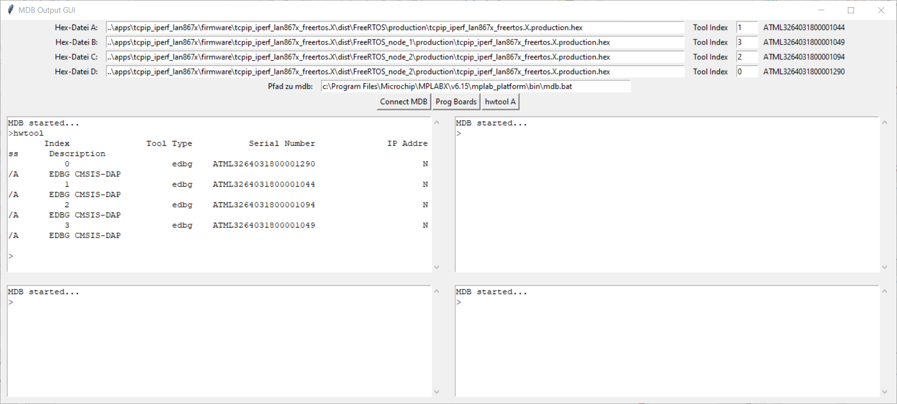
Python GUI for parallel Programming with MDB
„hwtool“ is a MDB command that lists all available debuggers and assigns them an index number. This index number is used to select the debugger

Slide 10
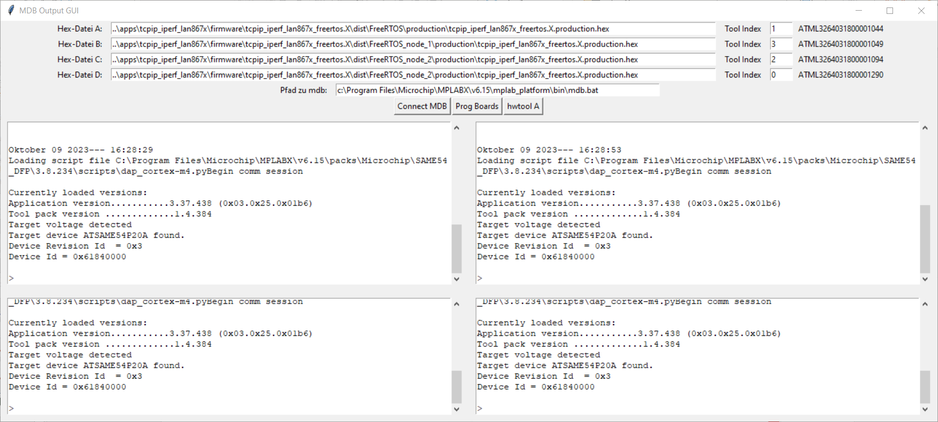
Python GUI for parallel Programming with MDB
With clicking on „Connect MDB“, all setup is done for EDGB, Speed 6Mbit, SWD Interface and selecting the debuggers. This takes some time until it‘s connected

Slide 11
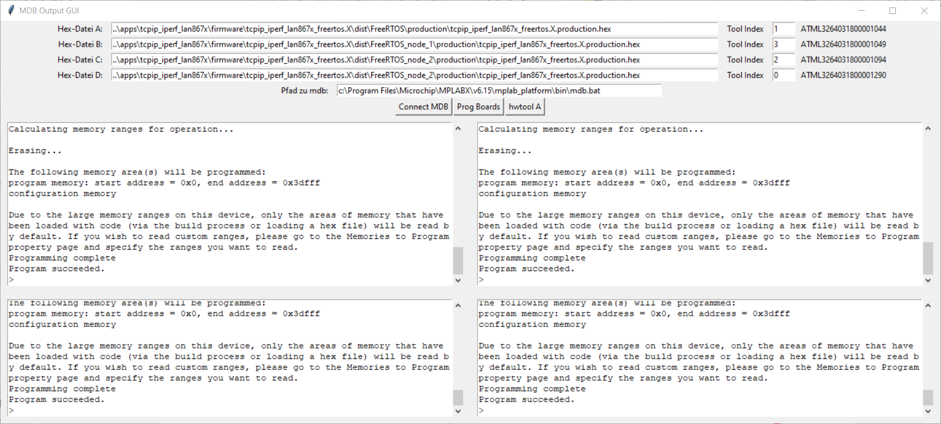
Python GUI for parallel Programming with MDB
“Prog Boards” programs all Hex files. The connection to the debugger is maintained so it is not necessary to re-establish the connection again. This allows the programming process to start more quickly.

Slide 12
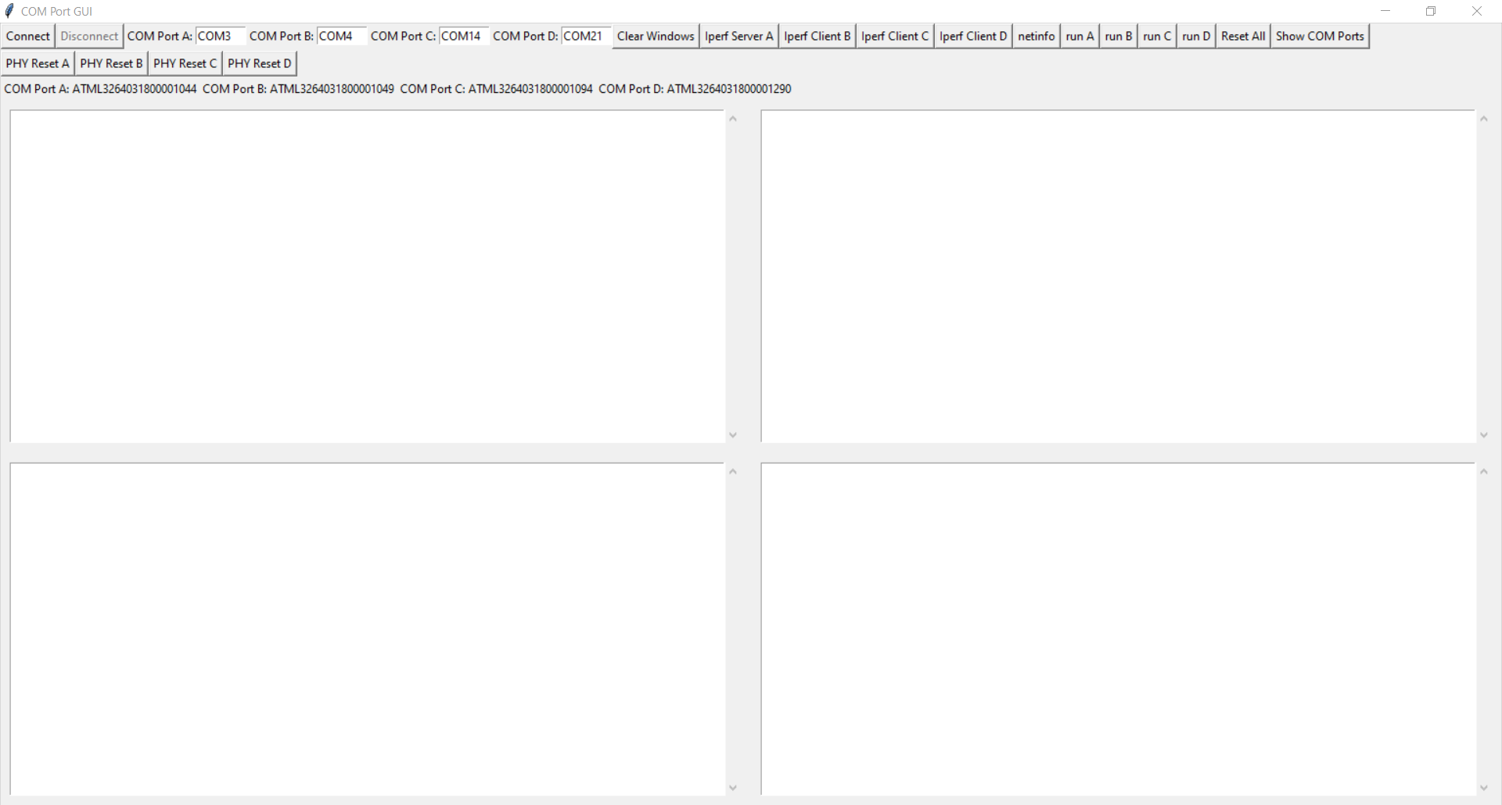
Python GUI for testing 4 Boards in parallel
This tool is basically a 4-way Comport Terminal.
There are 4 default COM ports in the upper left, which must be changed to the ones on your machine.
If a COM Port entry is left free, this COM port is not used, so that this tool can be used with less than 4 boards

Slide 13
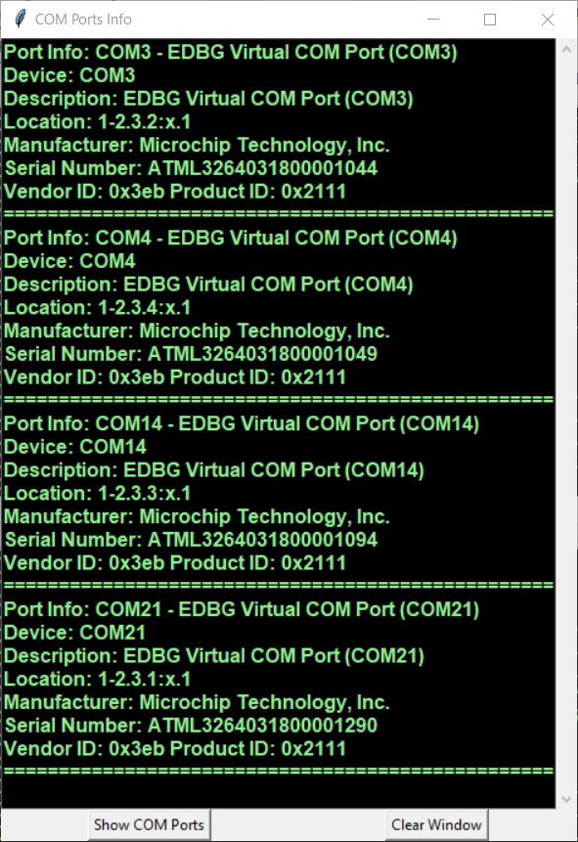
Python GUI for testing 4 Boards in parallel
A
B
C
D

Slide 14
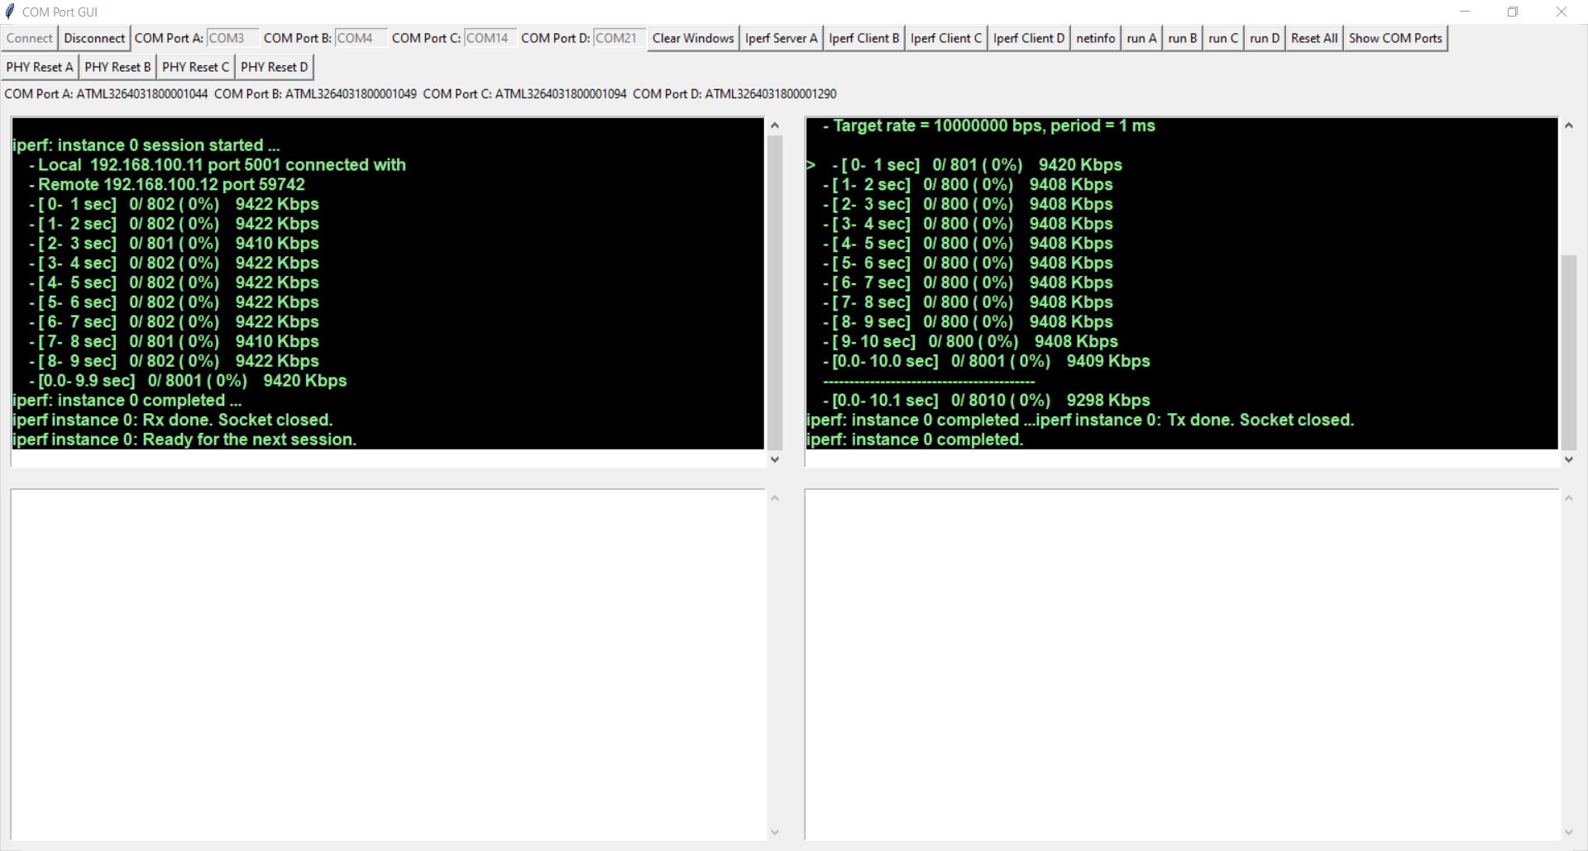
Python GUI for testing 4 Boards in parallel
A Bandwidth of approx. 9.4 Mbit/sec UDP traffic is achieved between two boards

Slide 15
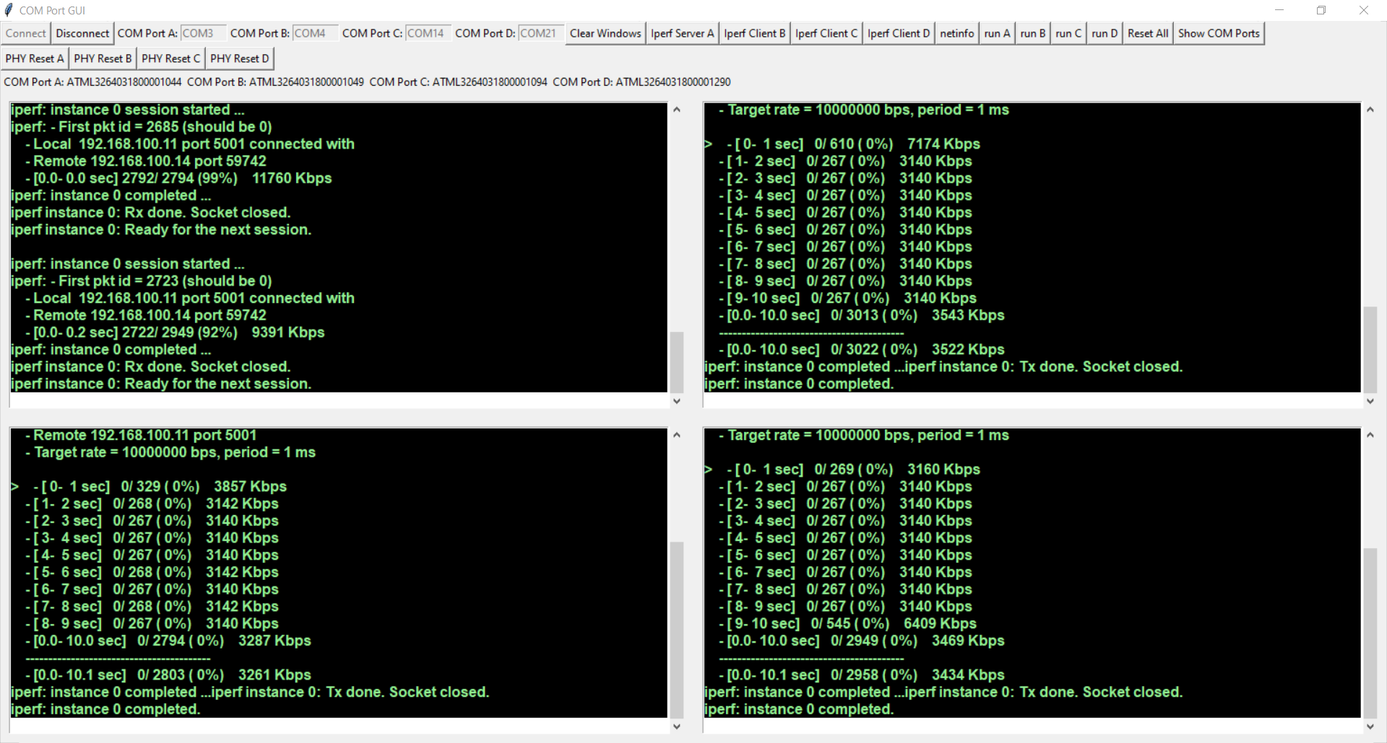
3 iperf client’s at the same time
A Bandwidth of approx. 3.1 Mbits/sec UDP Traffic is achieved when 3 iperf clients are running simultaneously

Slide 16
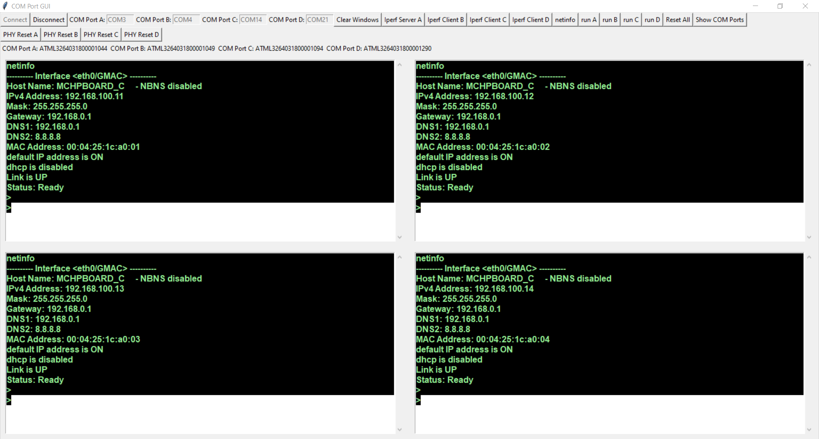
Sending the command “netinfo” to all boards
Pre defined commands can be send to one or more boards at the same time when a button is clicked.

Slide 17
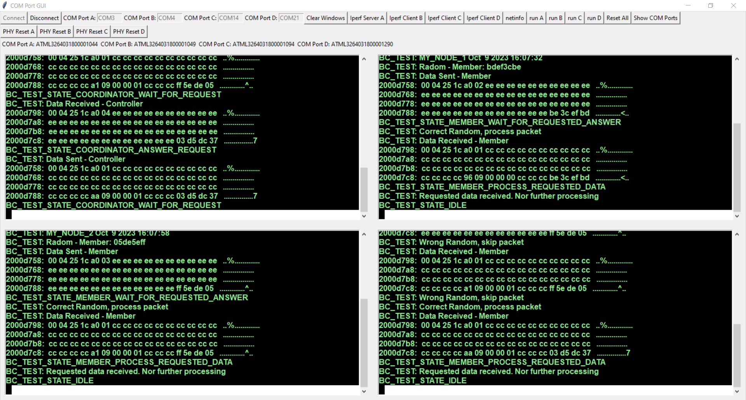
Testing UDP commucation between boards
When it comes to test communication protocols, the 4 terminals make it much more convenient to debug the firmware by locking into the output of the boardsboa
This firmware starts with “run” the sending of an UDP Broadcast packet. If until 5 secs there was no answere, the fm decides to be the “COORDINATOR” which answers to such packets. Inside this UDP packets, a timestamp is also exchanged so that all Boards LED’s can blink synchronously every 2 secs

